Slide 1

TAM
[ FLOWTRADERS AI HACKATHON 2023 ]
Telegram Automated Marketmaker

Slide 2




The Team
Miles Child
Charlie Roth
Michael Shindler
Sharon Sung
Trading Operations
Trading Operations
Trading
Business Development

Slide 3
Table of contents
Team
Product Viability
Demonstration
Application architecture
Artificial intelligence & scalability
Financials

Slide 4
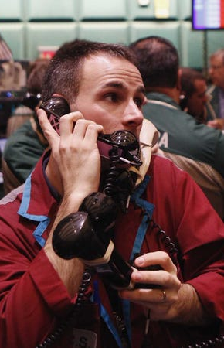
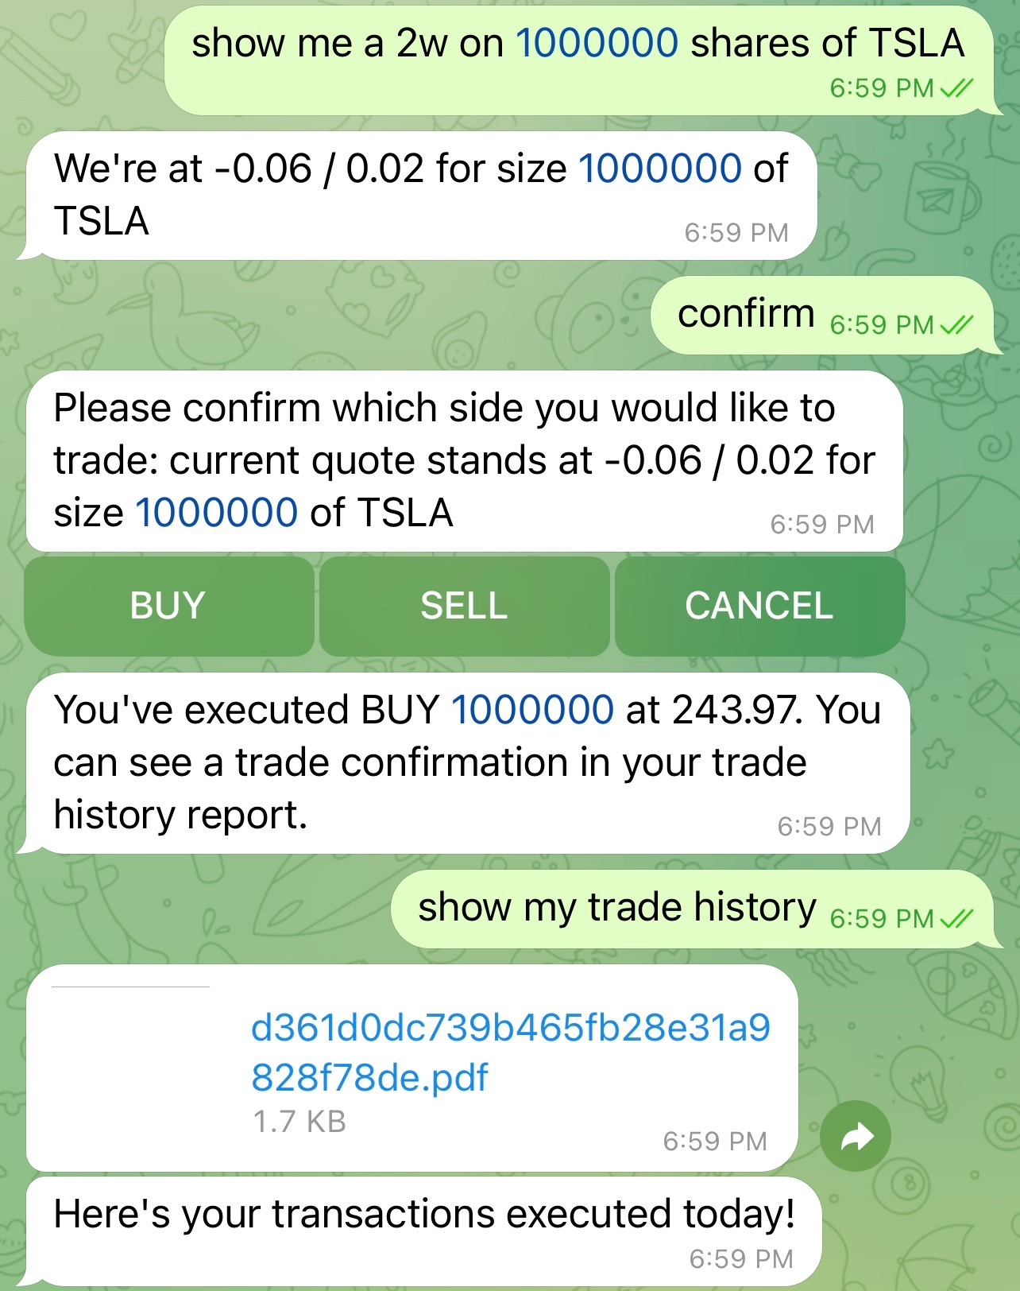




Product Viability
Counterparty Convenience:
- 24-hour access to an always-responsive, easy-to-navigate, and easy-to-access RFQ platform
- Work with a model that quickly learns your firm-specific RFQ lingo
Increased Efficiency:
- Respond to more RFQs while simultaneously streamlining headcount costs
- Allows broker-dealers to compete on pricing, not speed
Seamless integration across numerous chat platforms
Notes:
Volumes from RFQs and OTC trades make up a large portion of overall trading volumes across all asset classes and regions​
Selling this as a service product to market makers, brokers, and institutions. Clients can streamline their headcount, reduce costs, and respond to more RFQs across all asset classes. ​
Integration into all chat forms (Slack, Webex, Teams, etc.) allows for products to put this into any chat platform that is currently not recognized as being compliant for message storing and makes that communication channel compliant.​
Since we plan to sell this to all broker-dealers and market makers, this allows them to compete on pricing, not on speed.​
​

Slide 5
Demo
Linked in description

Slide 6
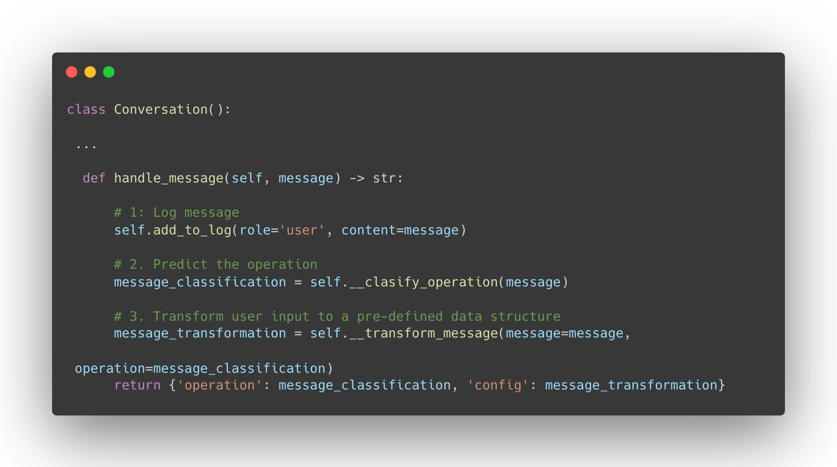
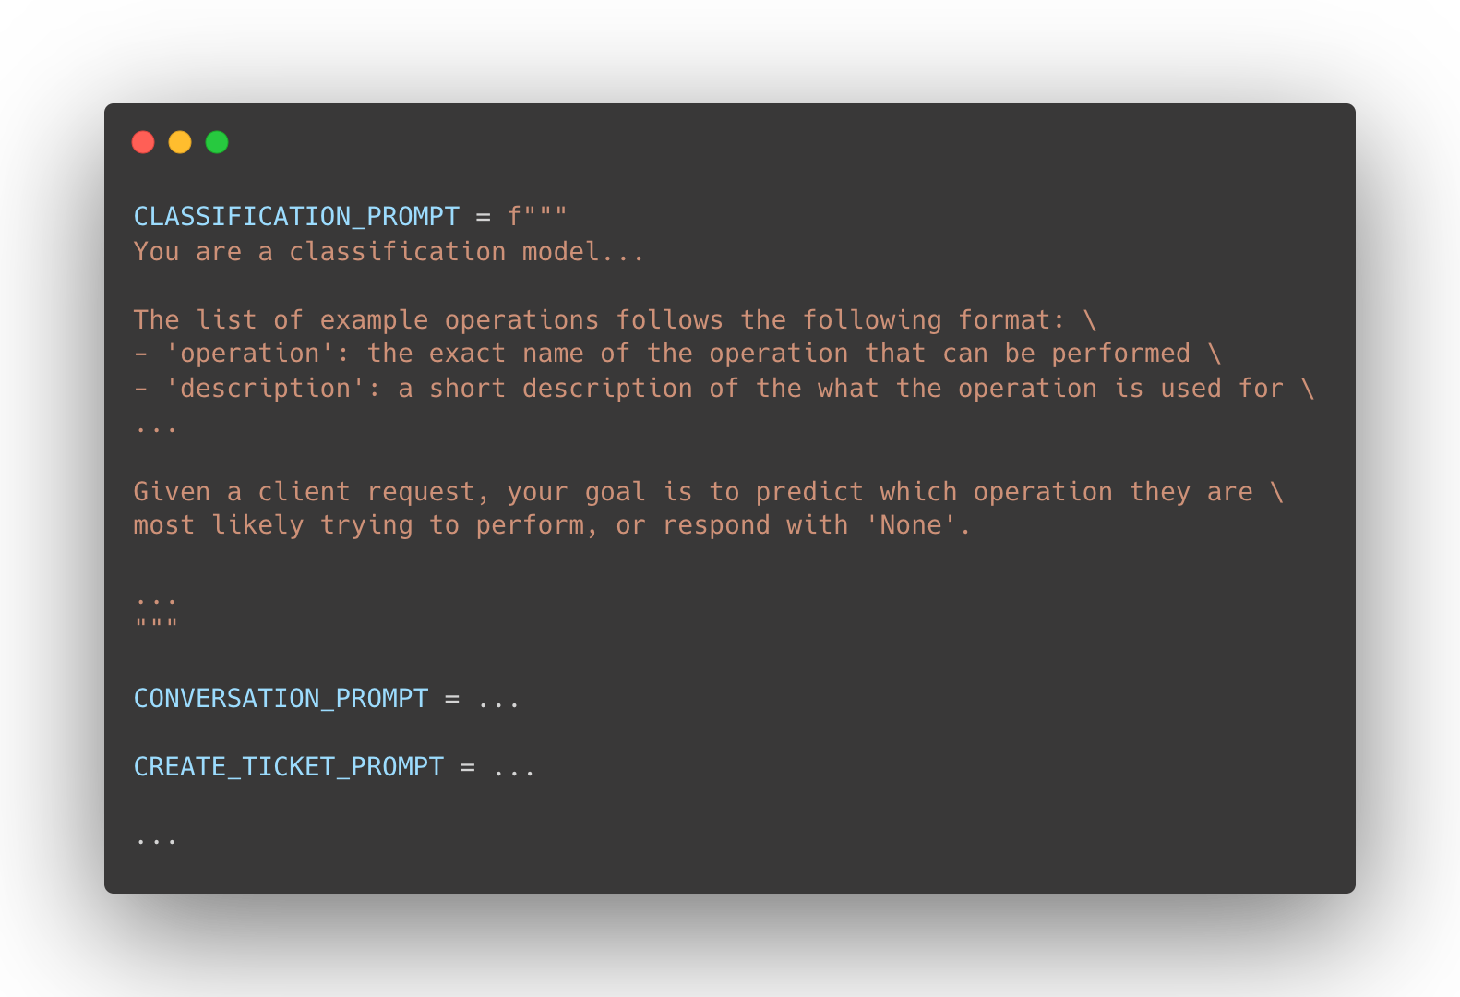
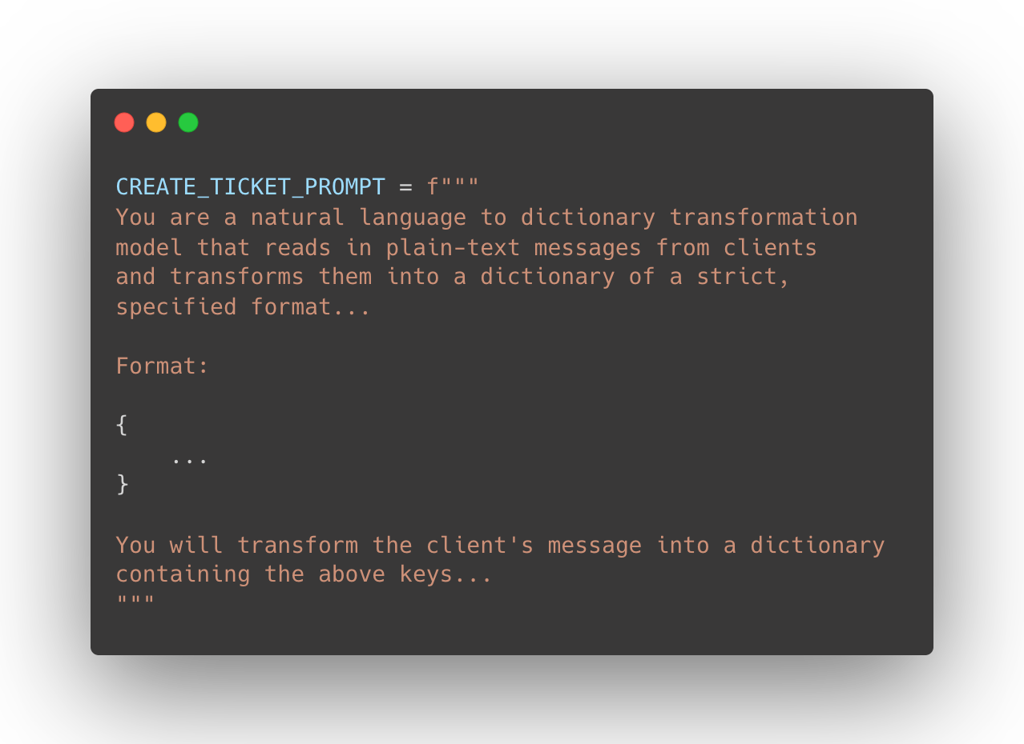
AI
Conversation Structure:
- Clients can communicate with tam_bot as if they are having a conversation
- Our implementation spawns new conversations at each api call to minimize token use and only re-uses past interactions when necessary
GPT Prompts:
- Each client message is first scraped to determine the desired operation
- Once the operation is determined, we use a transformer prompt to reformat their RFQ (or other request) into a standard format

Slide 7
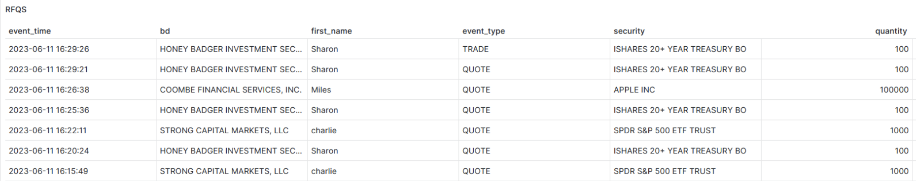
AI & Scalability
Plans for further enhancement of the TAM_bot infrastructure using AI
Counterparty Behavior Analysis
Central Store of CP Information
TAM_bot stores all client interactions in LT and in-memory data facilities.
hibiscus db
Stored data on client interactions allows us to compile statistics and train models on specific CPs
TAM_bot can be configured to train hyper-specific, CP-unique prompts and pricing strategies based on stored chat and transaction history
hibiscus dashboard
Hyper-accurate and fully scalable CP-unique LLMs for RFQ
Learned CP ranking and dynamic price improvement models
Higher Win Rate
Tighter Spreads
Notes:
Centralization and extremely precise documentation of client interactions will allow our customers to quote tighter spreads, win more quotes, win more customers, and maintain more efficient markets
We’ve left the road open for seamless integration of quote-improvement models, like
Counterparty behavior analysis and individually-curated prompts/strategies for higher-profile CPs
As we aggregate trade and chat history
Learned CP ranking system and dynamic quote improvement
Easy integration of pricing strategies as enrichment processes to the main quote pricing model

Slide 8
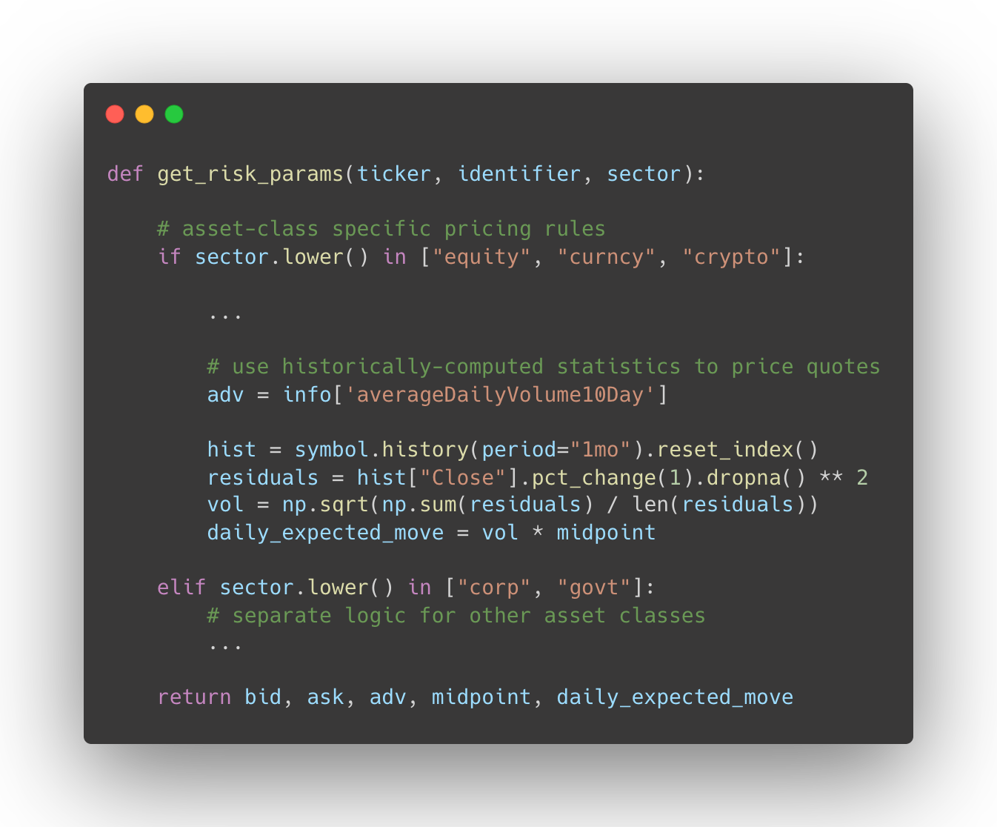
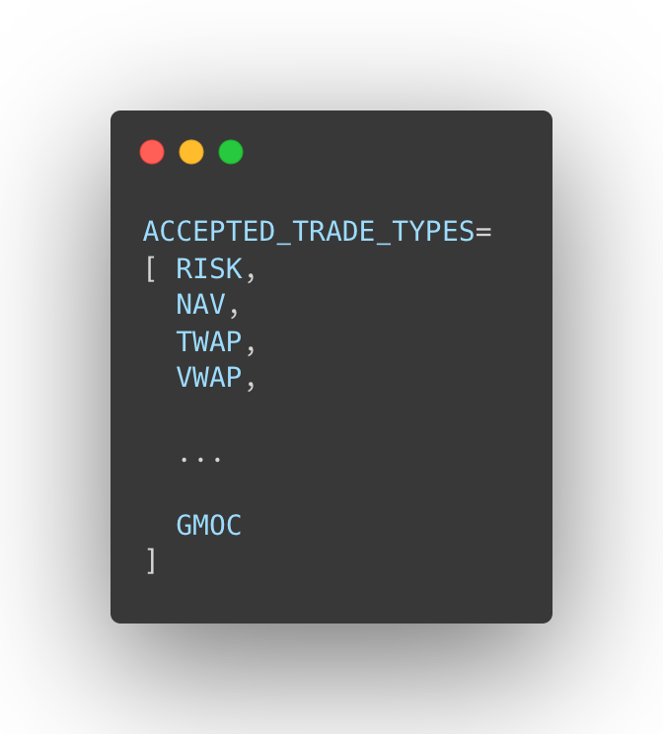
Pricing & Risk Model
Risk & Trade Isolation:
- Our pricing engine breaks down types of RISK and different classes of trades to optimize our positioning and the quotes we show
Compatible across multiple markets
- TAM_bot can soon reach all market participants, pending implementation of a few asset classes
- Currently supports equities, fixed income, crypto, and forex
Notes:
We developed a novel pricing engine to break up different types of risk and price it as competitively as possible.​
By enabling the pricing of risk quotes, NAVs, GMOCs, and others types of trades across myriad asset classes we can integrate with many different market participants​
Using volatility, market impact projections and position adjusted pricing models we've also built a framework that works on its own, and can be added onto with more pricing improvements and even counterparty prediction models​

Slide 9
Market Positioning & Opportunity
Product | Cost/yr. @ 1 user | Cost/yr. @ 100 user
Bloomberg Terminal | $25,000.00 | $2.5M
TAM_bot | $5,000.00 | $25,000.00
TAM_bot will offer a baseline subscriptions for individuals and a comprehensive enterprise solution including onboarding and consulting
Item | Proj. Cost FY 2023 | Proj. Cost FY 2026
Research & Development | $500,000.00 | $100K – $250K
Operating Expenses | $750,000.00 | $1.5M – $2.0M
Hosting occurs off site at no cost to Hibiscus
Op-Ex forecasted to remain under ~$2M through FY26
Notes:
At a price of USD 25,000 per year to license the Enterprise software (which includes software updates and onboarding consultation) This puts us in comp with a singular Bloomberg Terminal which is a charge PER USER! ​
Given the markets need to streamline, automate and reduce headcount costs. We project a 10% US market penetration within the first 2 years which would give us an ARR of USD 10M. Since all hosting is done off-site at no capex to Hibiscus, our only costs are Op-Ex which we plan to keep under USD 2M per year between a team of 5 developers​
Additional sources of revenue can be found by offering hosting and other services to end users. While we will offer this, we do not expect it to be a large part of our revenue stream​
In 5 years we plan to have 50% market penetration in the US as well as 10% penetration in both Europe and APAC, putting us at projected ARR of USD 70M​
In 10 years we plan to be at 90% US market penetration around 50% in both APAC and Europe with ARR USD 190M​
Based on these numbers we have a current pre-revenue valuation of USD 10M​
​

